Slide 1
B09S0061 Software Engineering
Lecture 3
Instructor: Liu, Guangchi Ph.D.
2024/03/07
Notes:
本模板基于“中国科学院大学-路人丁-PPT模板”魔改而成，著作权归该作者所有。
本模板中使用的东南大学校徽、校标文字组合、校训文字等素材来自于微信公众号“金木屋”。
本模板的视觉设计参考了“东南大学视觉识别系统”。
人物介绍页头像素材来自 小肥柴。
本模板力求简洁，布局合理，主次分明。以学术风为设计理念，适用于学术报告与论文答辩等相关应用场景。模板未使用任何动画效果。
您仅可以以个人非商业用途使用本PPT模板，不可将信息内容的全部或部分用以出售，或以出租、出借、转让、分销、发布等其他任何方式供其他人使用。
欢迎 持续关注东南大学止于至善学术风 PPT 模板 （https://zhuanlan.zhihu.com/p/335298500）后续的功能优化及多语言更新版本。
最后，祝汇报顺利，马到成功！
Version: (2021) v1.5-en.

Slide 2
Heads up
Team up ASAP and start to brainstorm your final project!
Team members are recommended to sit together in the class
In the first lab (J6-101, Mar 29th, 14:00-17:25), you (as a team) should present
Project name
Team members
Feasibility Study
Project Schedule
Requirements (analysis/elicitation, modeling, specification)

Slide 3
01
PART ONE
Requirements Analysis

Slide 4
Requirements
Requirements describe the function of the system from the client‘s viewpoint. The requirements establish the system's functionality, constraints, and goals.
The requirements must be understandable by both the client and the development staff.
The development team and the client need to work together closely to define the requirements.

Slide 5
Why are Requirements Important?
Causes of failed software projects
Incomplete requirements 13.1%
Lack of user involvement 12.4%
Lack of resources 10.6%
Unrealistic expectations 9.9%
Lack of executive support 9.3%
Changing requirements & specifications 8.8%
Lack of planning 8.1%
System no longer needed 7.5%
Failures to understand the requirements led the developers to build the wrong system.
Source: Standish Group

Slide 6
The Requirements Dilemma
Defining the requirements can be divided into several steps
Analysis to establish the functionality by consultation with client, customers, and users. Modeling to organize the requirements in a systematic and comprehensible manner. Define, record, and communicate the requirements.
Heavyweight processes go through these steps for the entire system before beginning the design.
With lightweight processes, these steps are done separately for each sprint.

Slide 7
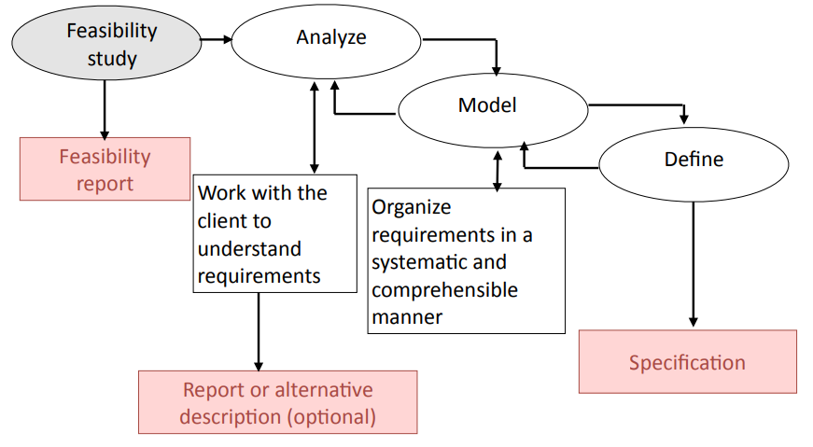
Requirements Steps

Slide 8
The Requirements Dilemma
You cannot build a system unless you know what it is required to do.
BUT …
Clients may have only a partial understanding of requirements.
When they see the system, they ask for new features.
Frequently, they ask for major changes.
These changes may force you to rework large parts of the system. These are problems for both heavyweight and lightweight processes
OOP saves your life!

Slide 9
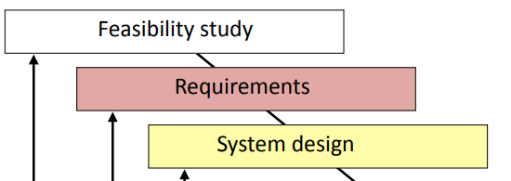
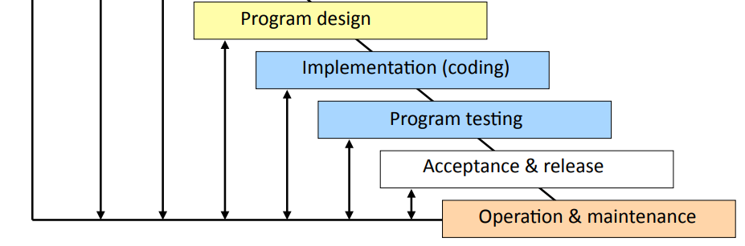
Heavyweight Processes: Modified Waterfall Model

Slide 10
Requirements in Heavyweight Processes
Heavyweight processes expect detailed specification
Written document that specifies each requirement in detail.
Carefully checked by client and developers.
May be a contractual document.
Will be used for acceptance testing.
Difficulties
Specification is time consuming and difficult to create.
Specification is hard to maintain.
Checking a detailed specification is tedious.
Clients rarely understand the implications.
The difficulty of creating and maintaining a detailed requirements specification is one of the reasons that many organizations prefer lightweight development processes.

Slide 11
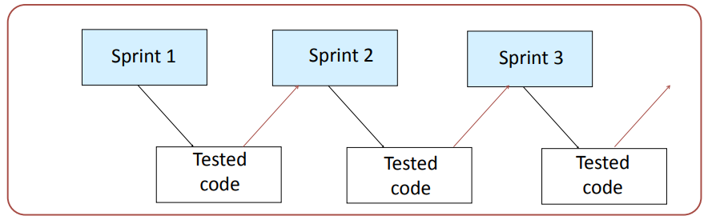
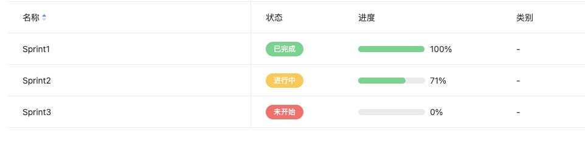
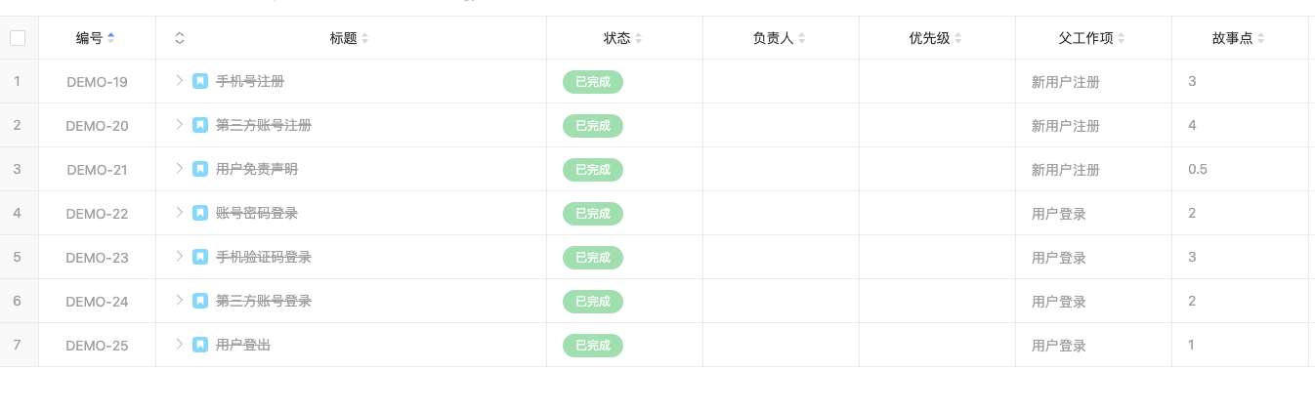
Lightweight Processes: Agile Development
Each sprint has its own set of requirements.

Slide 12
Requirements in Lightweight Processes
Lightweight processes develop the requirements one sprint at a time.
Working code is used for checking the requirements.
Client and developers work jointly on the requirements.
Minimal documentation is created during the sprint.
Fuller documentation is needed for future maintainers, but details are provided in the code.
Difficulties
Some requirements are system-wide and cannot be defined within a single sprint, e.g., data bases, security architectures, overall user interface design.
The requirements of future sprints may lead to major rework of earlier sprints.

Slide 13
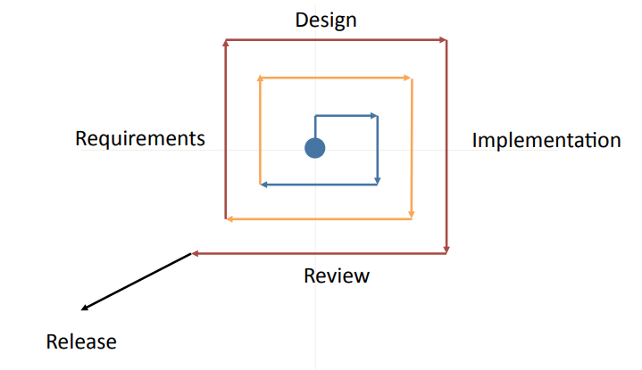
Middleweight Processes: Iterative Refinement
The requirements are revised for each iteration.

Slide 14
Requirements in Middleweight Processes
Middleweight processes develop the requirements iteratively.
The first iteration has an outline of the main requirements.
Each iteration refines the outline and add details.
Documentation is needed for future maintainers, but details are provided in the code.
Difficulties
Each iteration may require major rework of previous work.
Developers often patch new requirements onto previous iterations.

Slide 15
Which is better?
For a large system, you have to be flexible. Both heavyweight processes and lightweight process have problems.
BUT …
Both types of process work well, if used sensibly.
When using a heavyweight process, such as the modified waterfall model, specify the requirements in moderate detail, but be prepared for revisions. Some details can be left until later in the process.
When using a lightweight process, such as agile, develop system-wide requirements and the overall system architecture early in the process, perhaps before beginning the regular sprints.

Slide 16
Requirement Goals
Understand the requirements in appropriate detail.
Ensure that the client and developers understand the requirements and their implications.
Define the requirements in a manner that is clear to the client. This may be a written specification, prototype system, or other form of communication.
Define the requirements in a manner that is clear to the people who will design, implement, and maintain the system.
"Our understanding of your requirements is that ...”

Slide 17
Requirements Analysis: Interviews with Clients
Client interviews are the heart of the requirements analysis
Clients may have only a vague concept of requirements
Allow plenty of time.
Prepare before you meet with the client.
Keep full notes.
If you do not understand, delve further, again and again.
Repeat what you hear.
Small group meetings are often most effective

Slide 18
Requirements Analysis: Understand the Requirements
Understand the requirements in depth
Domain understanding: Learn new things all the time
Example: Manufacturing light bulbs
Understanding the terminology
Clients often use specialized terminology. If you do not understand it, ask for an explanation “We don’t have no money”
Understanding of the real requirements of all stakeholders
Clients may not have clear ideas about what they require, or they may not express requirements clearly.
Keep asking questions, “Why do you do things this way?” “Is this essential?” “What are the alternatives?
“What you thought AI is like v.s. What AI is really like”

Slide 19
Requirements Analysis: New and Old Systems
Clients often have an old system that is so familiar that they do not realize that it has functions that are not needed in a new system.
A replacement system is when a system is built to replace an existing system.
A legacy system is an existing system that is not being replaced, but is being extended or must interface to a new system
Question: Do we need to still to keep this old function?
Case Study: Tesla
In requirements analysis it is important to distinguish:
features of the old system that are needed in the new system
features of the old system that are not needed in the new system
proposed new features

Slide 20
Requirements Analysis: Unspoken Requirements
Discovering the unspoken requirements is often the most difficult part of developing the requirements.
Examples:
Resistance to change
Departmental friction (e.g., transfer of staff)
Management strengths and weaknesses

Slide 21
Stakeholder Analysis
Identify the stakeholders (Who is affected by this system?)
Client
Customers
Users (many categories)
Senior management
Administrators
Computing staff
Example:
Web shopping site (shoppers, administration, finance, warehouse)

Slide 22
Viewpoint Analysis
Viewpoint Analysis
Analyze the requirements as seen by each group of stakeholders.
Example: University Admissions System
Applicants
University administration
Admissions office
Financial aid office
Special offices (e.g., athletics, development)
Academic departments
Computing staff
Operations and maintenance

Slide 23
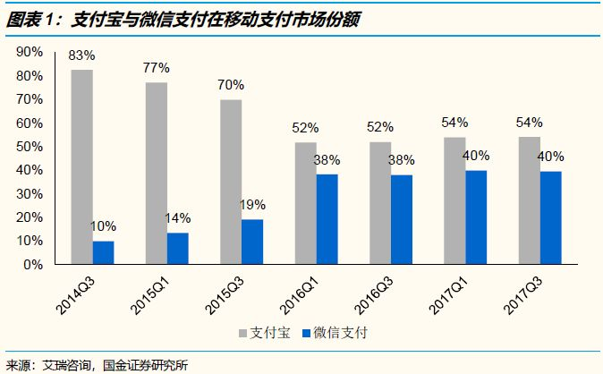
Special Studies
Understanding the requirements may need studies:
Technical evaluation
experiments, prototypes, etc.
Example: Windows XP boot faster
Market research
focus groups, surveys, competitive analysis, etc.
Example: WeChat Pay，Filming
With data driven methods, they often come together

Slide 24
Specifying Requirements: Realism and Verifiability
Requirements must be realistic, i.e., it must be possible to meet them.
Wrong: The system must be capable of x (if no known computer system can do x at a reasonable cost).
Illusion about LLM
Requirements must be verifiable, i.e., since the requirements are the basis for acceptance testing, it must be possible to test whether a requirement has been met.
Wrong: The system must be easy to use.

Slide 25
Specifying Requirements: Realism and Verifiability
Requirements must be realistic, i.e., it must be possible to meet them.
Wrong: The system must be capable of x (if no known computer system can do x at a reasonable cost).
Illusion about LLM
Requirements must be verifiable, i.e., since the requirements are the basis for acceptance testing, it must be possible to test whether a requirement has been met.
Wrong: The system must be easy to use.
Right: After one day's training, an operator should be able to process 50 transactions per hour
Quantify your impact and KPI!

Slide 26
Agile: Releasing Code
With heavyweight processes, the requirements are defined by a full specification. With lightweight processes, the specification covers selected parts where there might be uncertainty.
Objectives
Record agreement between clients and developers
Provide a basis for acceptance testing
Provide visibility
Be a foundation for system and program design
Communicate with other teams who may work on or rely on this system or subsystem Inform future maintainers

Slide 27
Lightweight Processes
With lightweight processes, experience and judgment are needed to distinguish between details that can be left for later in the development process and key requirements that must be agreed with the client early in the process.
Examples where detailed specifications are usually needed
Business rules (e.g., reference to an accounting standard)
Legal restraint (e.g., laws on retention of data, privacy) Data flow (e.g., sources of data, data validation)
A common fault is to miss crucial details. This results in misunderstandings between the client and the developers. The whole intent of lightweight processes is to have minimal intermediate documentation, but you need some.

Slide 28
Lightweight Processes (continued)
Lightweight processes use a outline specification + other tools
Documentation describing key requirements in appropriate detail.
Reviewed by client and developers.
Details provided by supplementary tools, e.g.,
User interface mock-up or demonstration.
Models, e.g., data base schema, state machine, etc.
Clients understand prototypes and models better than specification
Iterative or incremental (agile) development processes allows the client to appreciate what the final system will do.

Slide 29
Functional Requirements
Functional requirements describe the functions that the system must perform. They include topics such as:
Transactions
Data
User interfaces

Slide 30
Non-Functional Requirements
Requirements that are not directly related to the functions that the system must perform
Product requirements performance, reliability, portability, etc...
Organizational requirements delivery, training, standards, etc...
External requirements legal, interoperability, etc...
Marketing and public relations

Slide 31
Example of Non-Functional Requirements
Example: Library
Use technology that the client's staff are familiar with:
Hardware and software systems (IBM/Unix)
Database systems (Oracle)
Programming languages (C and C++)
Recognize that the client is a federal library
Regulations covering government systems, e.g., accessibility to people with disabilities Importance of developing a system that would be respected by other major libraries

Slide 32
Requirements: Negotiation with the Client
Sometimes the client will request functionality that is very expensive or impossible to implement. Or two requirements may contradict each other.
This requires negotiation.
Talk through the requirement with the client. Why is it wanted? Is there an alternative that is equivalent?
Explain the reasoning behind your concern. Explain the technical, organizational, and cost implications.
Be open to suggestions. Is there a gap in your understanding? Perhaps a second opinion might suggest other approaches.
The client and development team must resolve these questions.
Example
National Science Foundation grant system, client asked for a huge range of formats. After negotiation, agreed that the first phase would support only PDF.

Slide 33
Requirements v. System Design
Technical decisions
Requirements analysis should make minimal assumptions about the system design.
But the requirements definition must be consistent with computing technology and the resources available.
In practice, analysis and design are interwoven. However:
1. Do not allow assumptions about the design to influence the requirements analysis.
2. Do not to allow the requirements analysis to prejudge the system design.

Slide 34
Requirements on Final Project
4. List all of the requirements (functional and non-functional) in your final report, and explain how did you identify this requirements
You can refer to the sample requirements provided
https://www.dropbox.com/s/61a7hg7tbw4p0nx/Mentcare%20requirements%20document.pdf?e=1&dl=0
https://www.dropbox.com/s/grgaaxtdas4oj1i/InsulinPumpRequirements.pdf?e=1&dl=0

Slide 35
02
PART TWO
Scenarios and Use Cases

Slide 36
Requirements v. System Design
Scenario
A scenario is a scene that illustrates some interaction with a proposed system.
A scenario is a tool used during requirements analysis to describe a specific use of a proposed system. Scenarios capture the system, as viewed from the outside, e.g., by a user, using specific examples.
Note on terminology
Some authors restrict the word "scenario" to refer to a user's total interaction with the system.
Other authors use the word "scenario" to refer to parts of the interaction.
In this course, the term is used with both meanings.

Slide 37
Describing a Scenario
Some organizations have complex documentation standards for describing a scenario.
At the very least, the description should include:
A statement of the purpose of the scenario
Choose a viewpoint
The individual user or transaction that is being followed through the scenario Assumptions about equipment or software
The steps of the scenario
In Agile development, a scenario is described as a user story

Slide 38
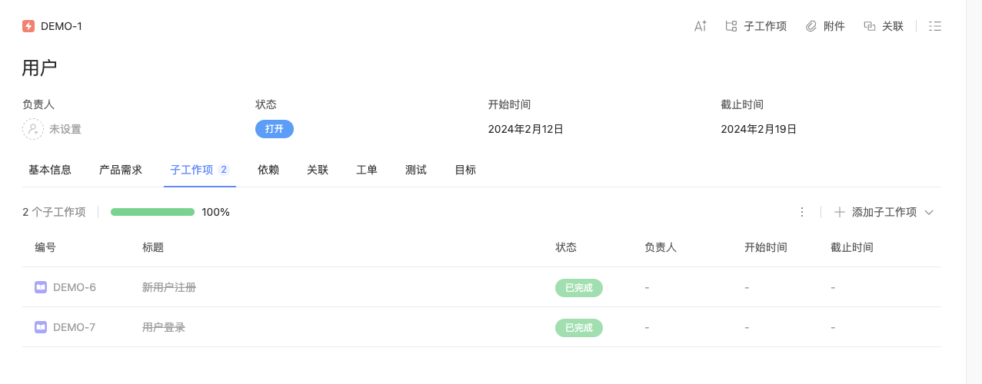
Agile: User Stories
Agile "user stories" - narrative scenarios with moderate detail
Often written on cards
Devs break into tasks to estimate effort
Prioritized by clients for inclusion in a sprint
Postponed stories may be revised with minimal rework

Slide 39
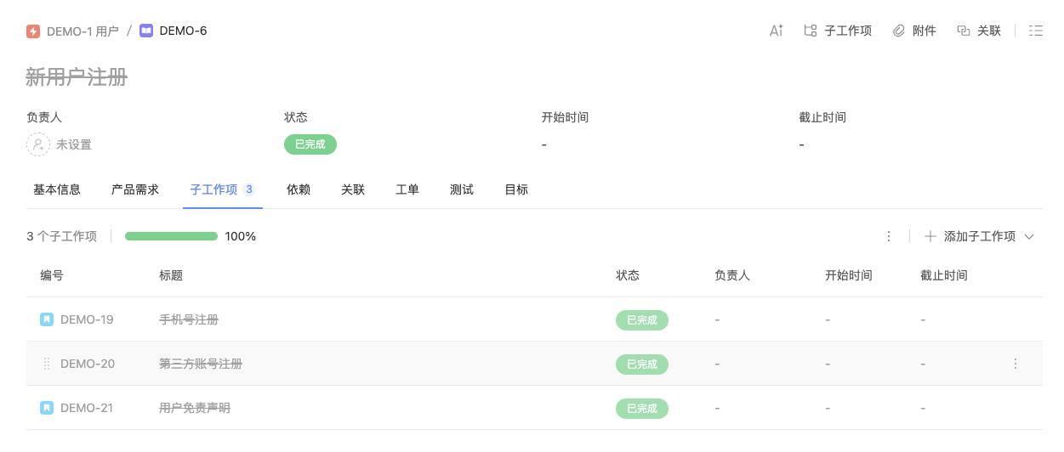
Agile: User Stories
Agile "user stories" - narrative scenarios with moderate detail
Often written on cards
Devs break into tasks to estimate effort
Prioritized by clients for inclusion in a sprint
Postponed stories may be revised with minimal rework

Slide 40
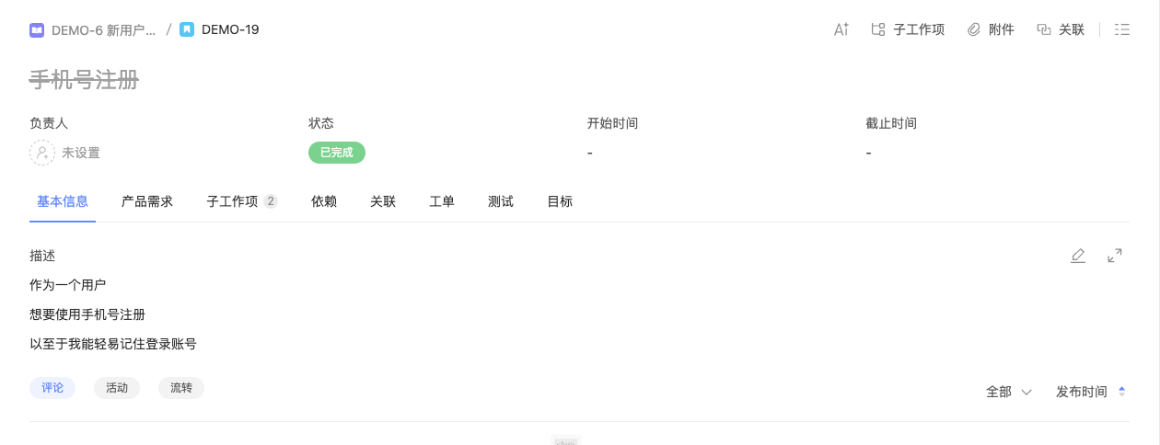
Agile: User Stories
Agile "user stories" - narrative scenarios with moderate detail
Often written on cards
Devs break into tasks to estimate effort
Prioritized by clients for inclusion in a sprint
Postponed stories may be revised with minimal rework

Slide 41
Developing a Scenario with a Client
Example of how to develop a scenario with a client
The requirements are being developed for a system that will enable university students to take exams online from their own rooms using a web browser.
Create a scenario for how a typical student interacts with the system
In the next few slides, the questions in red are typical of the questions to ask the client while developing the scenario.

Slide 42
Developing a Scenario with a Client: a Typical Student
Purpose:
Scenario that describes the use of an online Exam system by a representative student [Which viewpoint is this scenario based upon?]
Individual:
[Who is a typical student?] Student A, major in computer science. [Where can the student be located? Do other universities differ?]
Equipment:
Any computer with a supported browser. [Is there a list of supported browsers? Are there any network restrictions?]
Scenario:
Student A authenticates. [How does a college student authenticate?]
Student A starts browser and types URL of Exam system. [How does the student know the URL?]
Exam system displays list of options. [Is the list tailored to the individual user?]

Slide 43
Developing a Scenario with a Client (continued)
4. Student A selects Exam 1
A list of questions is displayed, each marked to indicate whether completed or not. [Can the questions be answered in any order?]
Student A selects a question and chooses whether to submit a new answer or edit a previous answer. [Is it always possible to edit a previous answer? Are there other options?]
[What types of question are there: text, multiple choice, etc.?] The first question requires a written answer. Student A is submitting a new answer. The student has a choice whether to type the solution into the browser or to attach a separate file. Student A decides to attach a file. [What types of file are accepted?]

Slide 44
Developing a Scenario with a Client (continued)
8. For the second question, the student chooses to edit a previous answer. Student A chooses to delete a solution previously typed into the browser, and to replace it with an a[ached file. [Can the student edit a previous answer, or must it always be replaced with a new answer?]
9. As an alternative to completing the entire exam in a single session, Student A decides to saves the completed questions to continue later. [Is this always permitted?]
10. Student A logs off.
11. Later Student A log in, finishes the exam, submits the answers, and logs out. [Is this process any different from the initial work on this exam?]
12. The Student A has now completed the exam. The student selects an option that submits the exam to the grading system. [What if the student has not attempted every question? Is the grader notified?]

Slide 45
Discussion
Scenario that describes the use of an online Exam system from a teacher’s viewpoint
Purpose:
Individual:
Equipment:
Scenario Steps:
Will be presented in next class!

